Slide 1
Natural Language Processing
CSE431/CSE712
Group no 10
Arnob Rahee 18101225
Sania Azhmee Bhuiyan 18101486

Slide 2
A Comparative NLP-Based Study on the Current Trends and Future Directions in COVID-19 Research
PRIYANKAR BOSE, SATYAKI ROY, AND PREETAM GHOSH
Problem Statement
COVID-19 is a global health crisis that has altered human life and still promises to create ripples of death and destruction in its wake
Objective
Natural language processing (NLP) based approaches to analyzie textual information of published articles in these areas can highlight research advances in virus-borne diseases in general, and COVID-19 in particular, and inform future directions on scientific research, clinical trials, course of treatment, socioeconomic implications and administrative decision-making.

Slide 3
Summary of the different facets of COVID-19 research.
AREA | DATASET | METHODS | KEY-TAKEWAYS
COVID-19 detection | Combined COVID-19 Dataset (321 and Noisy COVID-19 X-ray Dataset | Machine Learning and Deep Learning models | LWL-SOM performed better than the current machine learning models on this data
Bibiliometric analysis of COVID-19 | COVID-19 Bibiliometric data | Packages like VOSviewer Bibliometrix and R software | Identified some research themes but unable to address other themes like the long-term impact
Textual analysis of COVID-19 tweets | COVID-19 tweet data | Topic Modeling. UMAP, and DiGraphs | Identified the topics, key-terms and featured of COVID-19 tweets
Comparative analysis of COVTD- 19 research with respect to other coronavirus research | SARS, MERS and COVID- 19 publications dataset | Packages like VOSviewer. Biblioshiny and R software | Identified the influential aspects of different areas in coronavirus research
Topic Modeling: COVID- 19 Research with respect to ther coronavirus research | SARS, MERS, COVID- 19 and other CoV publications (CORD- 19) Dataset | Latent Dirichlet Allocation | Identified interrelationships between various coronavirus research to address knowledge gaps

Slide 4
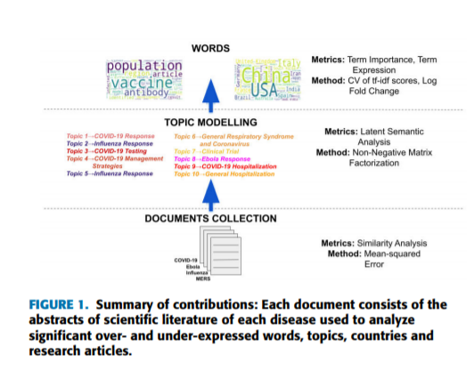
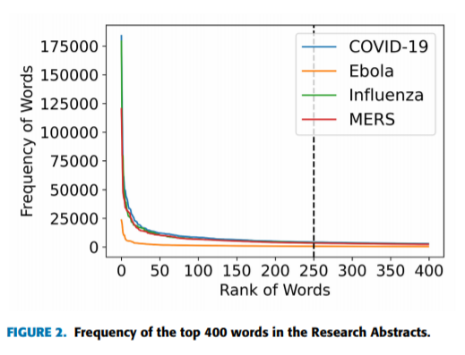
Important words in each disease document were categorized into:
Significant common Words
Similarity across diseases
Over-expressed and under-expressed words
In this section, different statistical and natural language processing methods applied during the textual analysis of the scientific literature on virus-borne diseases. We depict in Figure 1 that our analysis involves the identification of significant words in COVID-19 literature using metrics like coefficient of variation (CV), fold change, etc. We then apply latent semantic analysis to identify topics comprising these words. Finally, we study the similarities in the scientific literature of MERS, Ebola, Influenza and COVID-19.

Slide 5
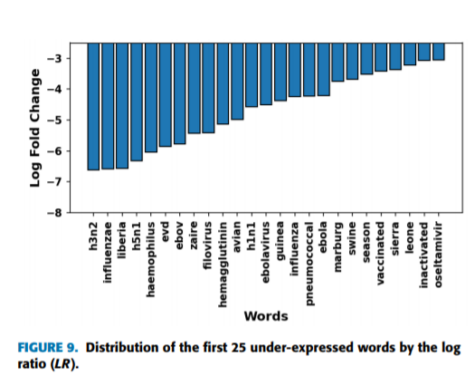
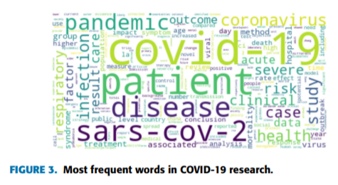

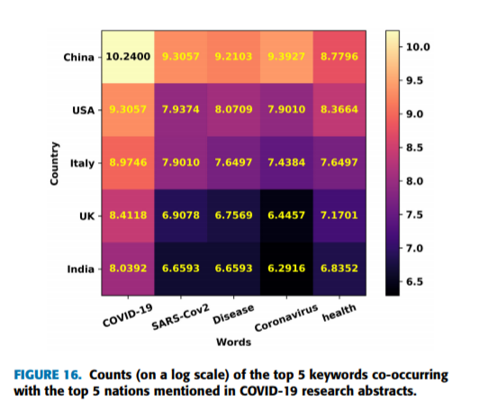
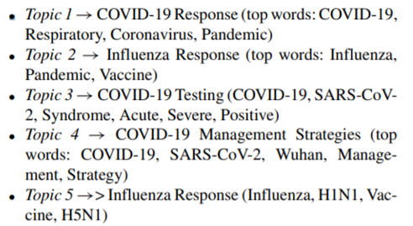
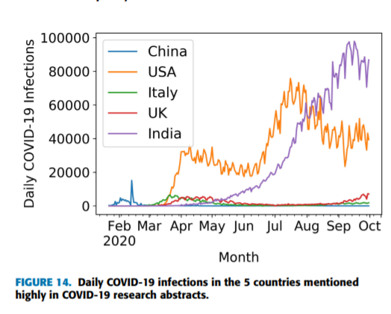
RESULTS
B. COMPARISON OF TERM EXPRESSION ACROSS DISEASES
IMPORTANT WORDS
C. SIGNIFICANT COUNTRIES
D. IDENTIFICATION OF RELEVANT TOPICS

Slide 6
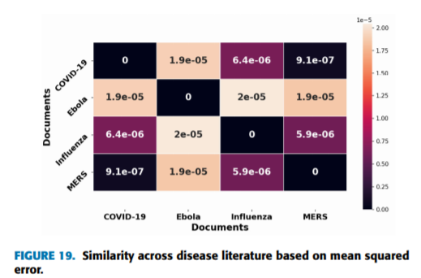
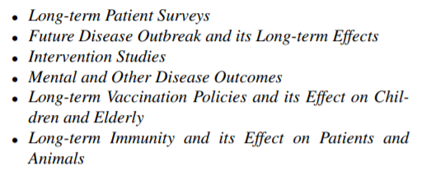
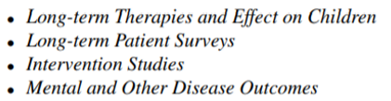
RESULTS Cont.
E. SIMILARITY ACROSS RESEARCH ON VARIOUS DISEASES
We calculate the mean squared error (MSE) of the tf-idf vectors of 403 common words of the disease pairs and represent the variation among diseases in the form of a heatmap
F. INFLUENTIAL RESEARCH ARTICLES
We discuss the first 10 influential research articles as the total number of significant words in the top 10 research articles ranges between 70 and 80. In [120], the success and safety of oral administration of the kinase inhibitor drug was assessed on COVID-19 hospitalized patients
G. IMPLICATIONS OF THE STUDY

Slide 7
LIMITATIONS OF THE STUDY
Our study is based on the research article data collected from PubMed .We restricted ourselves to the first 10,000 entries of each search topic allowed by PubMed.
Some results were incomplete with respect to title, author details, publication dates, and contents however, their number was too limited to skew the trends in our findings.
FUTURE WORK
Although we know that psychological problems are well associated with COVID-19 but there are not many works addressing its cause. Hence, it is important to identify whether lockdown or increased viral transmission or other factors are responsible for this illness.
Time-dependent topic modeling can also be insightful to understand the temporal patterns in the topics, and hence is an avenue for potential future work.

